Slide 1
ENSE 496AB
Milestone 3
Health-Esteem
October 25th, 2018
Jennifer Herasymuik | Shawn Clake
Tristan Heisler | Quinn Bast
Wilson Nie | Chengyu Lou
Notes:
Shawn

Slide 2
Team Introductions
Team Members:
Jennifer Herasymuik
Shawn Clake
Tristan Heisler
Quinn Bast
Wilson Nie
Chengyu Lou
Team Name:
Health-Esteem
Assigned Project:
Braintrust
Notes:
Shawn

Slide 3
USM Review and Rationalization
Envisioned Features
Drafts, amendments, idea status flow enforcement and administration of users, units and divisions.
Changes in the USM
Popups for reversible tasks have been removed. We also added functionality to allow email verification.
Rationalization
This release provides additional functionality to the user (drafts and amendments) while also allowing basic administration tasks within the application.
Notes:
Wilson

Slide 4
Timeline
Discussed MVP 2 requirements with Janice
Discussed DB
Group Programming Session
Practiced Presentation
Oct 16
Oct 19
Oct 23
Oct 11
Oct 16
Oct 22
Oct 25
Distributed MVP 2 Tasks
Group Programming Session
Made PowerPoint
Notes:
Wilson

Slide 5
Contributions
Team Member Main Priorities
Jenn - DB Redesign, Points, Amendment Submission, Unit/Division Soft Delete
Oscar - Unit Tests
Quinn - Unit Testing and Documentation
Shawn - Admin Panel, Unit/Division CRUD, Error Pages
Tristan - Amendments, PDCA Flow, Drafts, DB, User CRUD, FAQ Page
Wilson - Sign up and Login UI, Setting up Forgot Password and Email Confirmation.
There was overlap of these responsibilities among other group members.
Ie. We had a group discussion over DB design
Notes:
Wilson

Slide 6
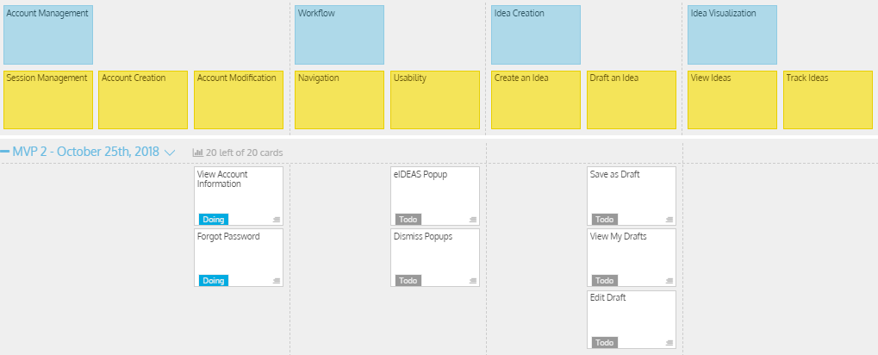
MVP 2/Milestone 3 USM - Original
Notes:
Tristan

Slide 7
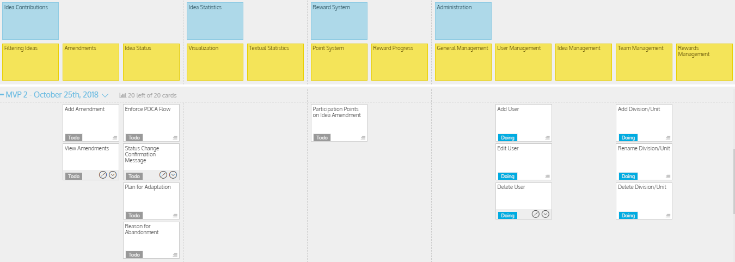
MVP 2/Milestone 3 USM - Original (cont.)
Notes:
Tristan

Slide 8
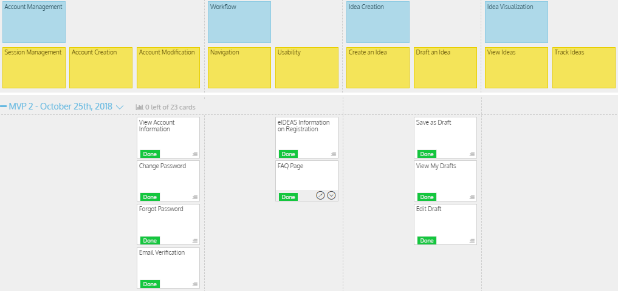
MVP 2/Milestone 3 USM - Modified
Notes:
Tristan

Slide 9
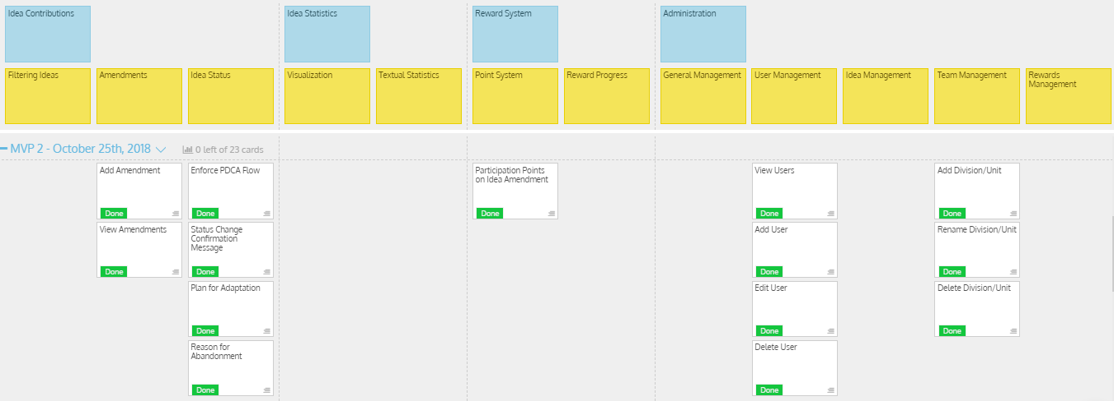
MVP 2/Milestone 3 USM - Modified (cont.)
Notes:
Tristan

Slide 10
Milestone 3
Demo
Health-Esteem
Notes:
Tristan

Slide 11
Discussion
Success
Implemented all user stories planned in MVP 2
Unit Testing was successful with over 40 tests created.
Documentation has been started and will be added to as the project progresses.
Database Redesign has been finalized for the rest of the releases.
Barriers
Hidden files have made implementing some features frustrating.
Notes:
Oscar

Slide 12
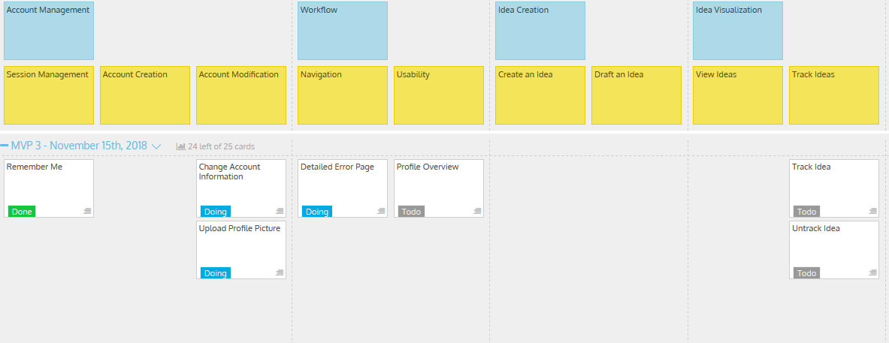
MVP 3/Milestone 4 USM
Notes:
Jenn

Slide 13
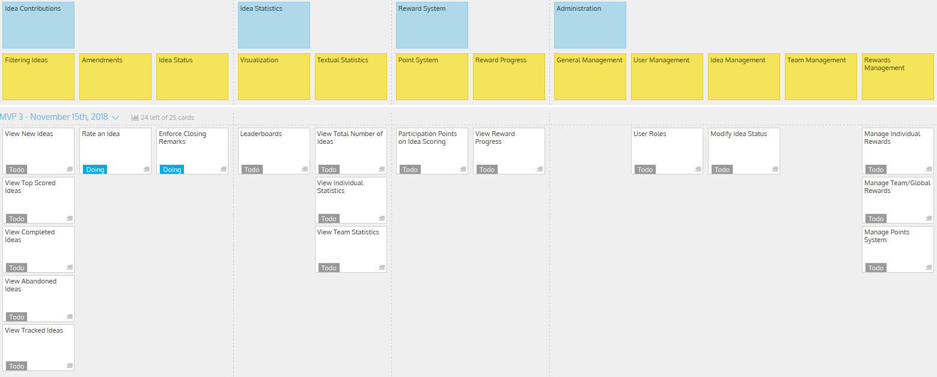
MVP 3/Milestone 4 USM (cont.)
Notes:
Jenn

Slide 14
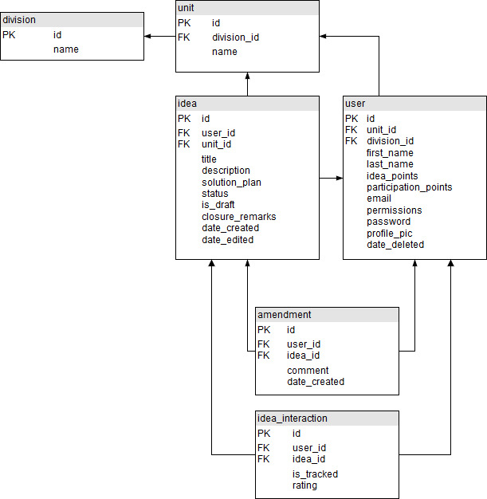
Database Design - Current UML
Notes:
Jenn

Slide 15
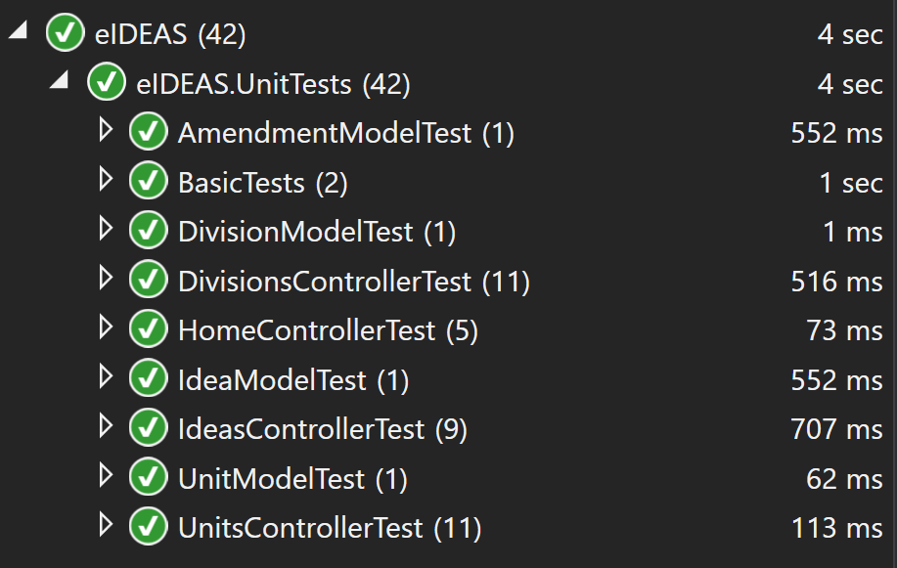
Testing
42 Unit tests
All passing
Testing created for:
Controllers - return correct views
Models - Update, Insert, Delete
Failing tests showed inconsistencies in soft/hard deletes. Changed controllers to enforce soft deletes.
Notes:
Quinn

Slide 16
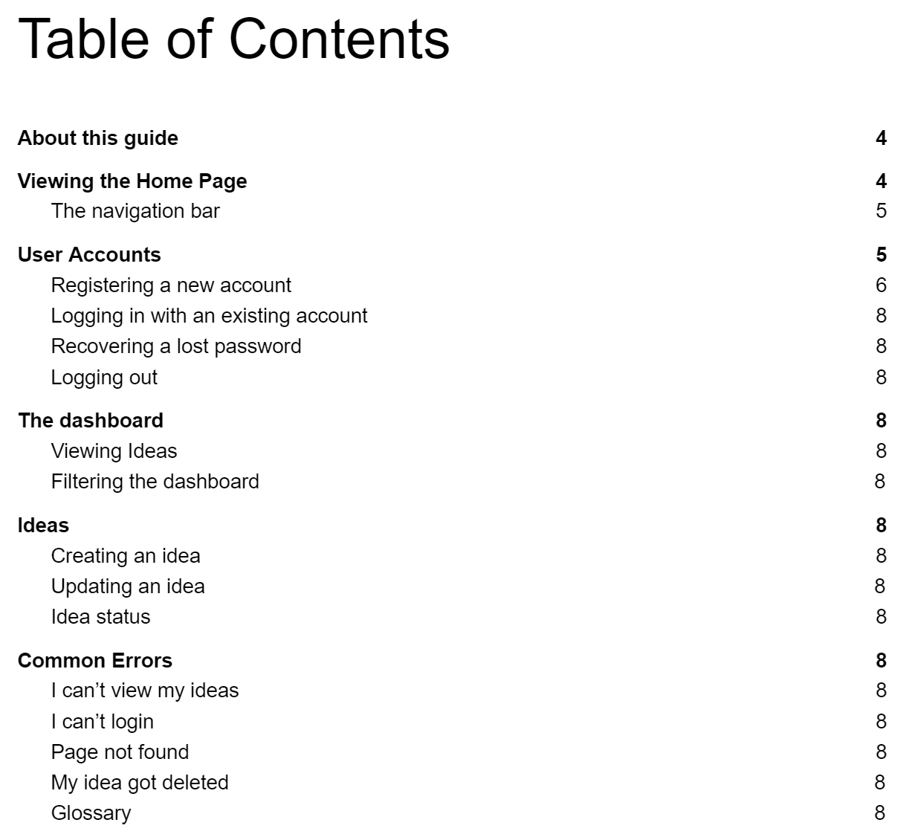
Documentation
Creation of a User Manual is in progress
Used to explain basic functionality of the web application at a low level to end users.
Currently have around 25% of the manual created
The remainder of the manual has been templated.
Notes:
Quinn

Slide 17
Group Reflection
How do you feel about this milestone? What do you like about it? What did you dislike?
Like: Implementing complex features is getting simpler as we gain experience
Dislike: Extending Identity is challenging due to hidden files and the inability to scaffold based off of our objects
Dislike: Implementing AJAX in Asp.net is tricky
What did you learn about yourself as you collaborated and worked through this milestone?
We are capable of working together to evaluate potential designs quickly and effectively. (Jenn and Tristan are passionate database designers)
Notes:
Shawn

Slide 18
Group Reflection (cont.)
How will you use what you have learned going forward?
We will use group programming sessions to evaluate and change designs as we implement them.
What “stuff & things” related to this milestone would you want help with?
An earlier mini-scrum, so that we can redirect our efforts based on feedback prior to the completion of the sprint. (Who needs midterms anyway)
eHealth template for User Manuals
Feedback on this milestone.
Notes:
Shawn

Slide 19
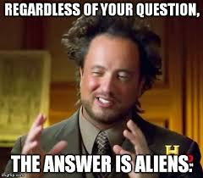
Questions?
Notes:
Shawn

